Slide 1
Sustainable finance & Banking
Prof. Dhafer SAIDANE

Slide 2
The Anthropocene
Is Classical finance ready for the ecological transition?
Icebreaker
https://app.wooclap.com/events/POJYOK/0
TOPIC 1

Slide 3
What are we going to analyze?
Main skills/competencies targeted: critical thinking
Assess the impact of Anthropocene
Identify the impact of traditional finance on climate issues.
Analyze the link between ecology and finance.
Design the 7 deadly sins of conventional finance,

Slide 4
7 Deadly Sins
1. Excessive short-termism
2. Ignorance of negative externalities
3. Over-accumulation of money (Aristotle's Chrematistics)
4. Opacity/neutrality of climate risks
5. Complexity of finance and disconnection from the real economy
6. Conflicts of Interest
7. Systemic greenwashing
Notes:
The main weak points of classical finance

Slide 5

Sustainable Finance
Terrific Indian prophecy
‘Only after the last tree has been cut down,
Only after the last river has been poisoned,
Only after the last fish has been caught.
Only then you will discover “money cannot be eaten.”
Proverb attributed to the Cree, a Native American tribe from what is now Canada:
Is money a commodity?
CHREMATISTICS in the Aristotelian sense
“IIt's about wanting more money without seeking to profit from it. The power of accumulating money as a commodity, not as a means of transaction.”
Aristotle
Marcel Jeucken (2001) Sustainable finance and banking : the financial sector and the future of the planet -Earthscan Publications Ltd
Notes:
DEBATE

Slide 6
Anthropocene: the beginning of the countdown/BREAKDOWN
The term Anthropocene means "The Age of Humans“ In Greek
Antropos Human being
Kainos New era/age.
It began when humans’ influence on ecosystems became significant on the scale of Earth's history.

Slide 7

Anthropocene: the beginning of the countdown /breakdown

Slide 8
Historical carbon dioxide emissions from fossil fuel from 1750 to 2025
(in billion metric tons)
We have now left the HOLOCENE (No human impact) and are in the transition to the ANTHROPOCENE (High human impact).
Anthropocene starting
We are leaving the HOLOCENE
Pre-industrial
Notes:
INTERPRETATION

Slide 9
Annual carbon dioxide (CO₂) emissions worldwide from 1940 to 2024 (in billion metric tons)
Annual global emissions of carbon dioxide 1940-2024

Slide 10
Global average temperature increase 1910-2019, by decade
Temperatures rise in the last 100 years around the world.
In the 1910s, global average temperatures were 0.38 °lower than the average temperatures between 1910 and 2000.
Today temperatures are 1.21° over the average.
4

Slide 11
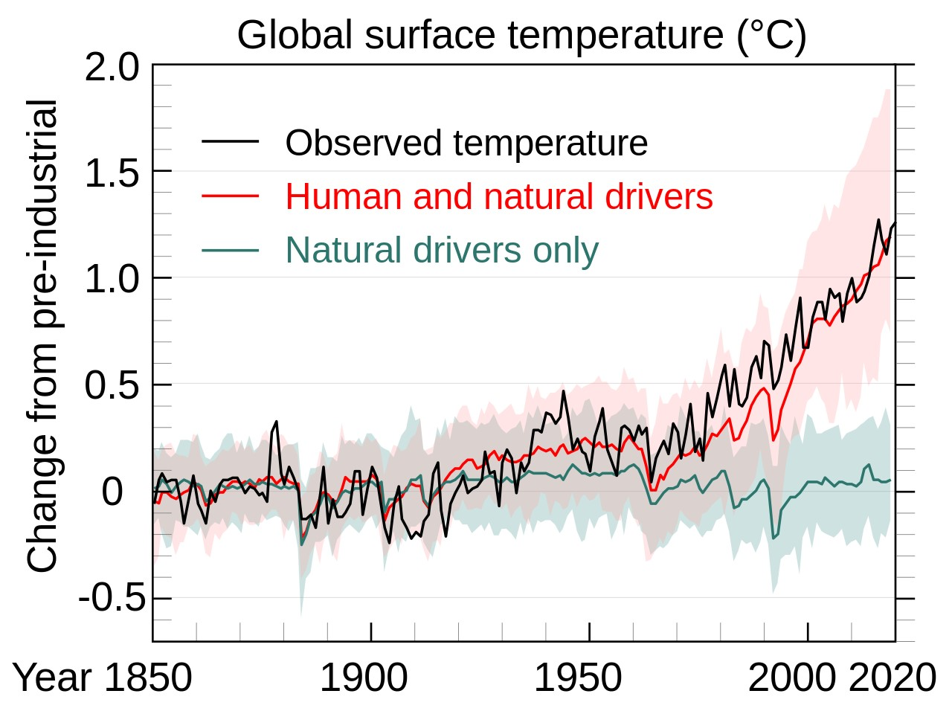
2015 Paris Agreement
Its goal is to hold “the increase in the global average temperature below 2°C above pre-industrial levels” and pursue efforts “to limit the temperature increase to 1.5°C above pre-industrial levels.”
Global Temperature since preindustrial +1.1%
https://climate.nasa.gov/

Slide 12

Carbon dioxide emissions from energy worldwide from 1965 to 2023, by region (in million metric tons of carbon dioxide)
Global carbon dioxide emissions from energy 1965-2023, by region
Emissions in MtCO₂
Who is responsible? Who is the victim?
Note(s): Worldwide; 1965 to 2023
Further information regarding this statistic can be found on page 8.
Source(s): Energy Institute; KPMG; Kearney; ID 205966
4

Slide 13
Largest global emitters of carbon dioxide 2021, by country
Share of CO₂ emissions
Notes:
Climate injustice refers to the paradox whereby the countries least responsible for global warming are those that suffer the most devastating consequences. This inequality demonstrates that developed countries, which have historically emitted the majority of greenhouse gases, struggle to bear the financial burden necessary to protect the most vulnerable countries.

Slide 14
New investment in renewable energy worldwide from 2004 to 2023 (in billion U.S. dollars)
Worldwide investment in renewable energy 2004-2022
Reminder: Global Energy Investment in 2023 is $2000 bi.
Renewable energy investment represents only 30% of Total Energy Investment
Description: In 2022, the total new investment in renewable energy amounted to approximately 495 billion U.S. dollars worldwide. This was a 17 percent increase from the previous year. Read more
Note(s): Worldwide; 2004 to 2022
Source(s): BloombergNEF
Notes:
This confirms that while investment in renewable energy is substantial at $600 billion, the vast majority of capital—$1,400 billion—is still directed toward non-renewable energy sources.

Slide 15
WORKGROUP EXPERIENCES
Experience 1: using exemplary behavior to reduce global warming
Experience 2: Using Bad Behavior to Increase GW
Two tools for applications
EN-ROADS
THE GLOBAL CALCULATOR

Slide 16
EN-ROADS: a « magic » climate simulator!
En-ROADS is a global climate simulator
Allows users to explore the impact of dozens of policies, such a:
transportation electrification,
carbon pricing,
agricultural practices
Affects hundreds of factors such as
energy prices,
temperature,
air quality
sea level rise.
ENJOY YOUR SIMULATIONS !
https://en-roads.climateinteractive.org/scenario.html?v=23.2.1&p39=64

Slide 17
Exercice structure (30 Minutes)
1. Briefing: The Challenge (3 minutes)
Context: Students are advisors to a global transition committee. The world in 2050 faces a choice: population growth vs. resource limits.
The Task: They must modify the structural drivers (Population, Diet, Energy Mix, and Industry) to reach a "sustainable" outcome in the dashboard before 2050.
2. Simulation & Trade-off Workshop (12 minutes)
Divide the class into 3 "Ministry" groups:
  Ministry of Agriculture: Focus on levers for "Diet," "Crop Yields," and "Land Use." (How do we feed 9 billion people without further deforestation?)
  Ministry of Energy & Transport: Focus on "Energy Supply," "Transport," and "Industry." (How do we electrify everything while maintaining grid stability?)
  Ministry of Economy & Infrastructure: Focus on "Efficiency," "Building standards," and "Lifestyle." (Can we maintain comfort with less consumption?)
Process: Each ministry has 4 minutes to propose a "package of measures" (e.g., increasing plant-based diets + doubling crop yields). You implement these in the Global Calculator and show the resulting energy gap or emissions.
3. Debriefing: The Reality Check (10 minutes)
Highlight the "Impossible Trinities" that appeared:
  Example: If they increased renewables (Energy Supply) but kept current diets (Land Use), did they run out of available land for energy production?
  Example: Did increased efficiency in industry offset the energy demand of a growing population?

Slide 18
Your mission: The 2050 Neutrality Summit
Objective: To design a policy pathway that limits global warming to 2.0°C or below by 2100, while navigating the complex trade-offs between economic performance, social equity, and technological capability.
1. Stakeholder Roles – 5 min
Split in 4 groups. Each group represents a core pillar of society with specific mandates. You must argue for your priorities while seeking consensus with other groups.
Economic & Industrial Group: Your focus is to maintain GDP growth, protect industrial competitiveness, and minimize energy price shocks.
Climate Justice Group: Your focus is on the Global South, poverty alleviation, and ensuring the costs of transition do not fall on vulnerable populations.
Energy & Technology Group: Your focus is on rapid innovation, grid resilience, and the scalability of new energy infrastructure.
Scientific Group: Your focus is the absolute carbon budget. You are the "reality check" that evaluates the physical outcome of the proposed policies.
2. The Negotiation Process – 20 min
Proposals: Each group will have 5 minutes to present their two preferred policy "levers" from the En-ROADS model.
Justification: You must justify your choice based on your specific stakeholder mandate.
Systemic Trade-offs: Be prepared for the facilitator to highlight the "side effects" of your choices—such as the impact of carbon taxes on economic growth or the transition time required for infrastructure changes.
3. Key Reflection Questions
As you negotiate, keep these questions in mind:
How do we balance short-term economic stability with long-term climate targets?
Which levers provide the most impact on temperature reduction with the least social friction?
What happens when our technological assumptions (e.g., carbon capture, renewables) do not scale as quickly as anticipated?
  Note: The climate is a complex system. Every action you take in the simulator will have a delayed, compounding effect. Focus on long-term systemic change rather than immediate fixes.
Notes:
3. Debriefing and Critical Analysis (5 minutes)
Why is it so difficult to reach 1.8°C?
Which levers had the most "surprising" impacts (e.g., carbon price vs. energy efficiency)?
How did the students manage the conflict between economic growth and climate urgency?
Tips for the Facilitator (Master's Level)
Use Advanced Graphs: Systematically display the "Global Temperature" curve and the "Energy Sources" curve to show the time lag between policies and results.
The "Silver Bullet" Trap: If students try to pull every slider at once, remind them that in reality, subsidies are limited and capital is finite.
Focus on Costs: Ask, "Who pays for the transition?" while manipulating sliders related to energy prices and taxes.
Why This Works for Master's Students
It forces them to move past binary answers (e.g., "we must stop oil") and adopt a risk management approach. They quickly realize that the "climate" is a complex system where every action has a delayed reaction, which is the essence of their future professional practice in business or administration.

Slide 19
The Global Calculator DASHBOARD
The Global Calculator is a model of the world's energy, land and food systems to 2050.
It allows you to explore the world's options for tackling climate change and see how they all add up.
With the Calculator, you can find out whether everyone can have a good lifestyle while also tackling climate change.
ENJOY YOUR SIMULATIONS !
https://tool.globalcalculator.net/globcalc.html?levers=22rfoe2e13be1111c2c2c1n31hfjdcef222hp233f211111fn2211111111/dashboard/en

Slide 20
Mission: 2050 Strategic Planning Brief
Goal: Propose a viable structural path for the world to 2050.
1. Stakeholder Mandates: Divide the class into 3 "Ministry" groups
Ministry of Agriculture: Your mandate is to ensure food security for a growing population. You must navigate the trade-off between land for nature, land for food, and land for bioenergy.
Ministry of Energy & Transport: You must replace fossil-fuel dependence with a reliable, scalable low-carbon mix. You are responsible for the physical feasibility of the energy transition.
Ministry of Economy & Infrastructure: You are responsible for efficiency. Your goal is to decouple human wellbeing from resource consumption through better technology and urban design.
2. The Negotiation Process
Constraint: You cannot touch every lever. You must negotiate with the other two Ministries to ensure that your combined changes do not exceed global resource limits (the "dashboard" indicators).
Systemic Trade-off: Identify one "bottleneck"—a resource (like land or electricity) that becomes scarce when you push your sector's goals too far.
3. Critical Thinking Questions
Which structural change (Diet, Energy, or Efficiency) had the most profound impact on the 2050 energy balance?
How does the population growth assumption limit the feasibility of the other levers?
Is it physically possible to maintain current "lifestyle" standards if the global population continues to consume at present rates?
Notes:
Exercise Title: "The Resource-Constrained Future: 2050 Strategic Planning"
Objective: Adjust structural levers to achieve a sustainable energy and food balance by 2050 while maintaining a hypothetical "Quality of Life" index.
Structure (20 Minutes)
1. Briefing: The Challenge (3 minutes)
Context: Students are advisors to a global transition committee. The world in 2050 faces a choice: population growth vs. resource limits.
The Task: They must modify the structural drivers (Population, Diet, Energy Mix, and Industry) to reach a "sustainable" outcome in the dashboard before 2050.
2. Simulation & Trade-off Workshop (12 minutes)
Divide the class into 3 "Ministry" groups:
Ministry of Agriculture: Focus on levers for "Diet," "Crop Yields," and "Land Use." (How do we feed 9 billion people without further deforestation?)
Ministry of Energy & Transport: Focus on "Energy Supply," "Transport," and "Industry." (How do we electrify everything while maintaining grid stability?)
Ministry of Economy & Infrastructure: Focus on "Efficiency," "Building standards," and "Lifestyle." (Can we maintain comfort with less consumption?)
Process: Each ministry has 4 minutes to propose a "package of measures" (e.g., increasing plant-based diets + doubling crop yields). You implement these in the Global Calculator and show the resulting energy gap or emissions.
3. Debriefing: The Reality Check (5 minutes)
Highlight the "Impossible Trinities" that appeared:
Example: If they increased renewables (Energy Supply) but kept current diets (Land Use), did they run out of available land for energy production?
Example: Did increased efficiency in industry offset the energy demand of a growing population?

Slide 21
ESG GLOBAL SCORE
Exercice
Let’s search for the ESG (Environment-Social-Governance) Score by country in Refinitiv ESG Database
https://workspace.refinitiv.com/web/Apps/Corp/?s=LSEG.L&st=RIC#/Apps/EnvtSocGov?view=dashboard
WOOCLAP on Anthropocene
https://app.wooclap.com/events/XKSDOU/0

